Slide 1
The Networker
February 20, 2025
Michel Biezunski, Infoloom
mb@infoloom.com

Slide 2
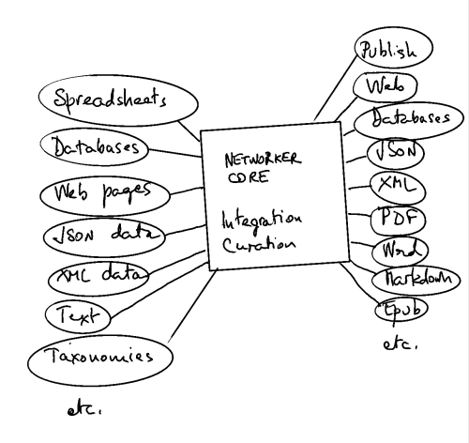
What is the Networker?
Platform to ingest, curate and publish taxonomies and knowledge graphs
Open Import/Export features
Super-easy to use. Can handle complex situations.
Usable as standalone or as middleware

Slide 3
Starting from Scratch
Create topics and relationships as you go.
Notes:
Use: NY - NY State - USA - North America - America
Add Texas and California.

Slide 4
Curation
Synonyms
Split

Slide 5
Taxonomies
Example:
Geographic

Slide 6
Views
Relations as topics
View by Relations
Graph View

Slide 7
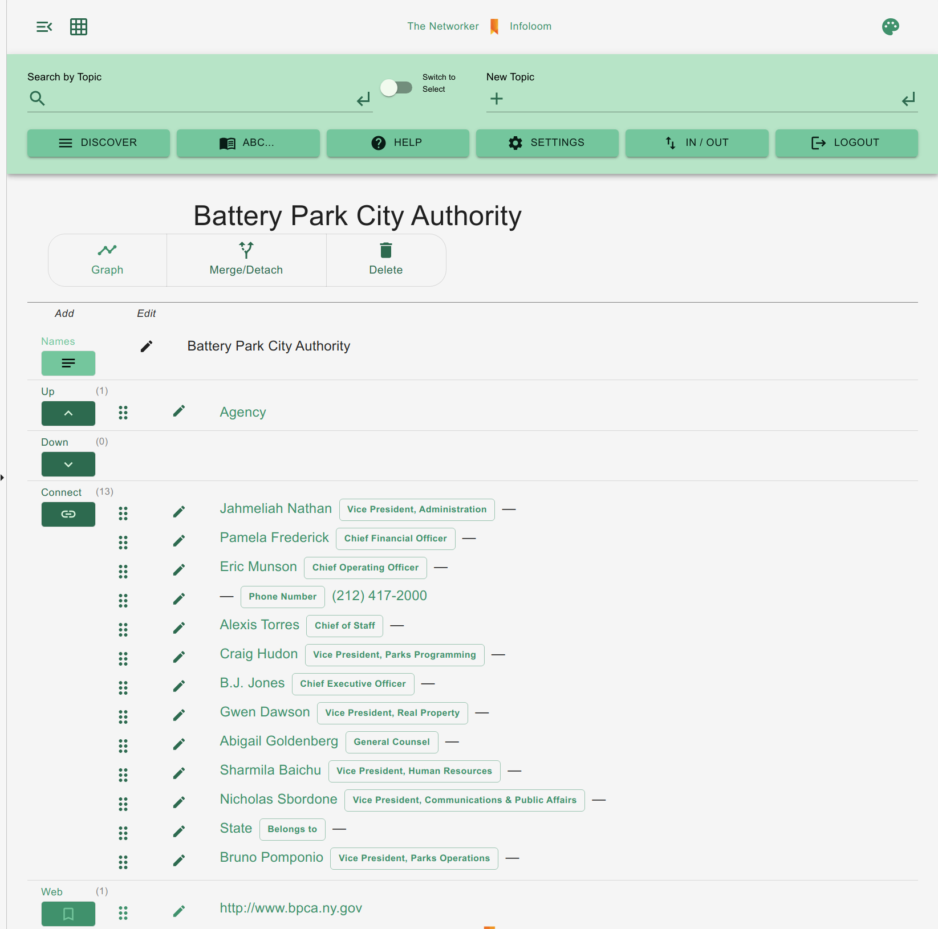
Greenbook

Slide 8
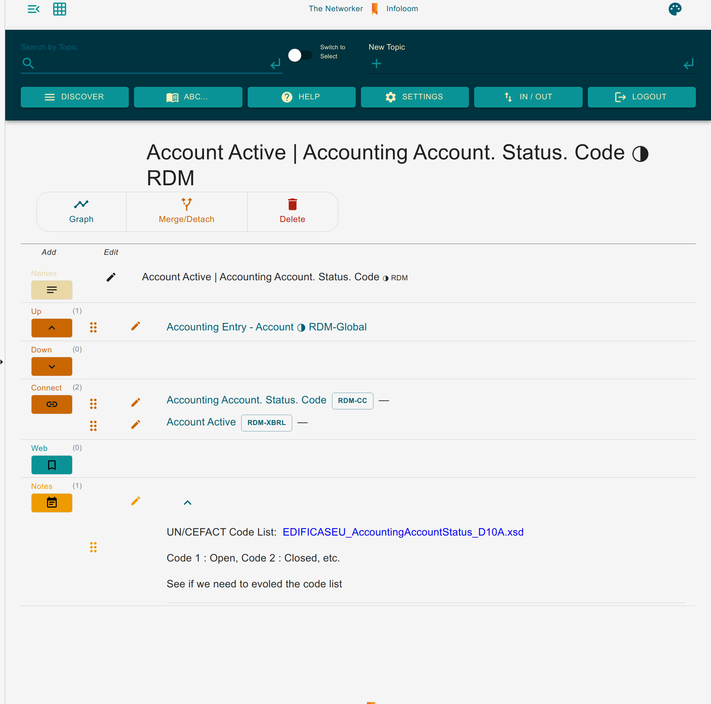
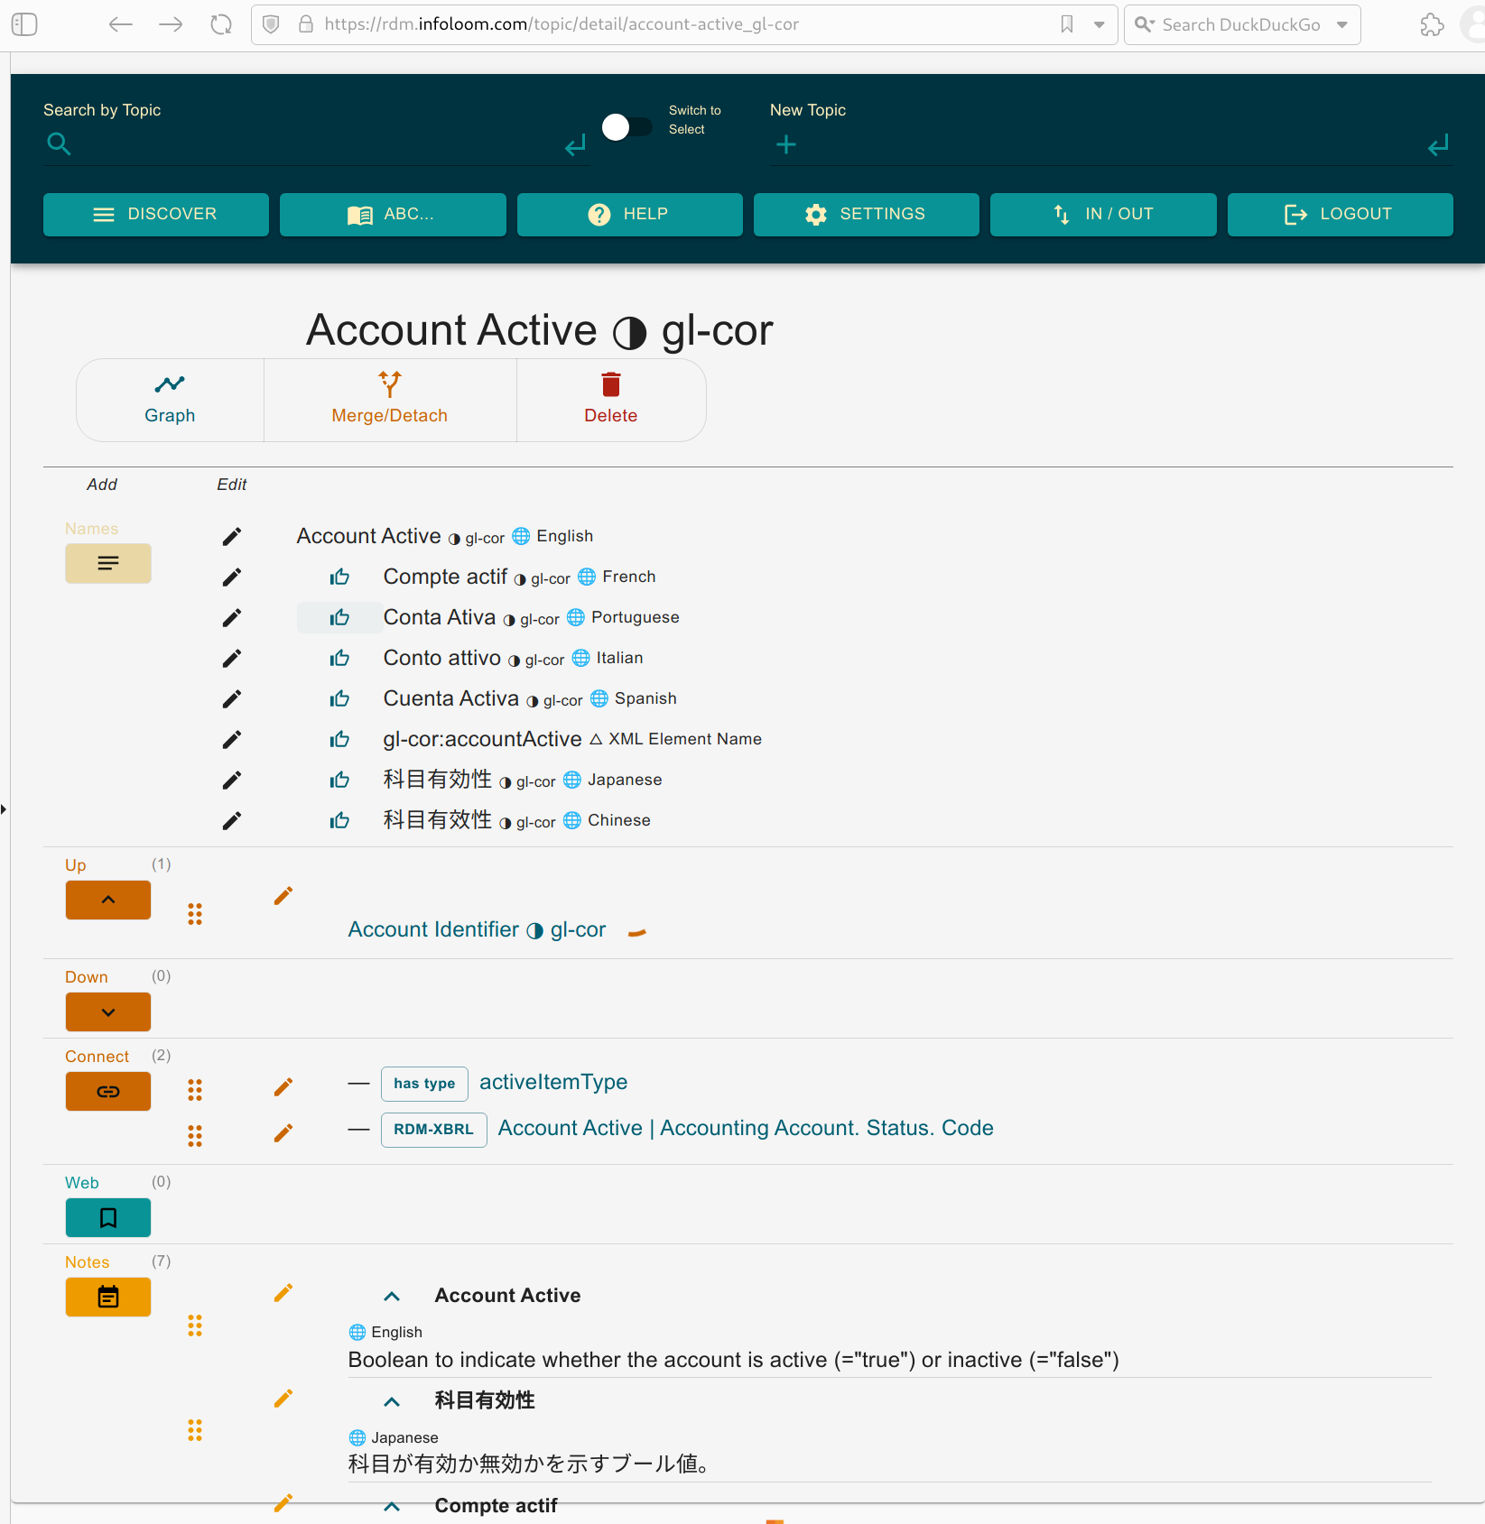
Multipoint Mapping

Slide 9
Links
https://networker.infoloom.com
https://infoloom.com
mb@infoloom.com

